Slide 1
Chromatin profiling in cancer cells
Name: Christian Schmidl
Position: Postdoc
Group: Bock
Date you started at CeMM: 1.12.2013
Confidential,
for internal use only

Slide 2
Why we have Friday Lab talks
To get feedback for my current and future computations/experiments
To get faculty feedback for my seminar presentation style
This is not a platform for praising past achievements!
Date of my last Friday lab talk:
Max of 3 things achieved since last lab talk:
One thing requiring feedback from this talk:
1:
Humboldt postdoctoral fellowship (24 months)
Established high-throughput protocols for chromatin analysis
Developed a novel ChIP-seq approach
2:
3:
Do you have further applications for the developed methods in mind?
Notes:
N.B. leave the black top comment on your slide – the one on the reasons we have Friday lab talks

Slide 3

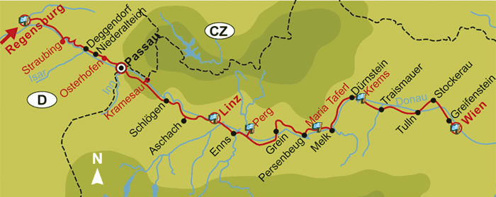
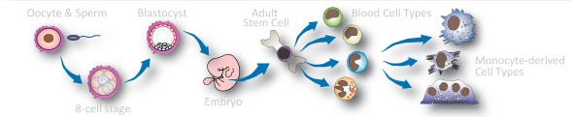

Regensburg – Vienna
PhD in Michael Rehli’s group at the University Hospital Regensburg, Germany
Role of chromatin in gene regulation of hematopoietic cells in collaboration with the FANTOM project

Slide 4
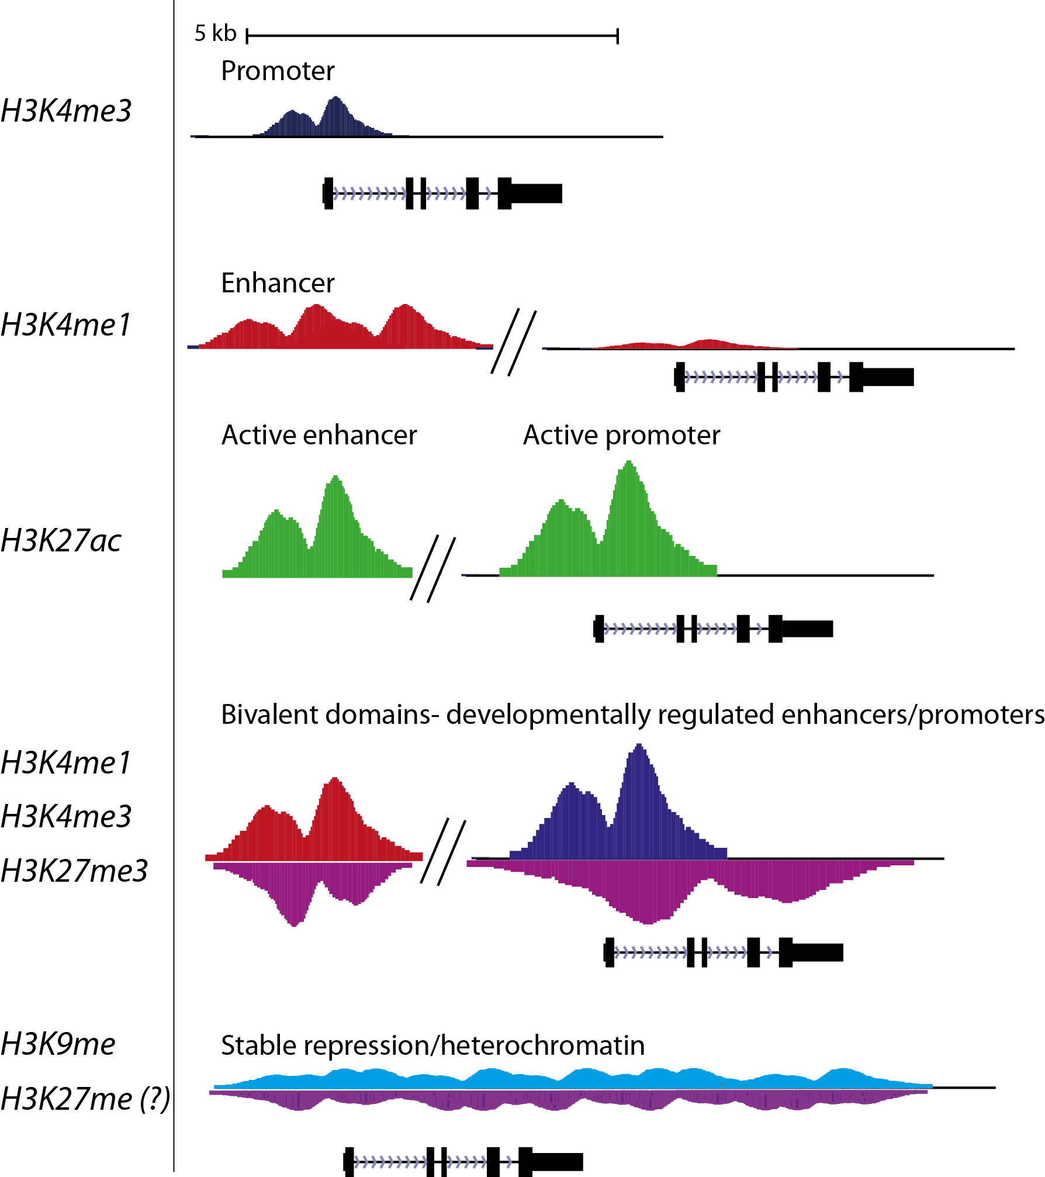
Background
Chromatin states – more than gene expression!
Function of DNA sequence
Activity
Potential

Slide 5
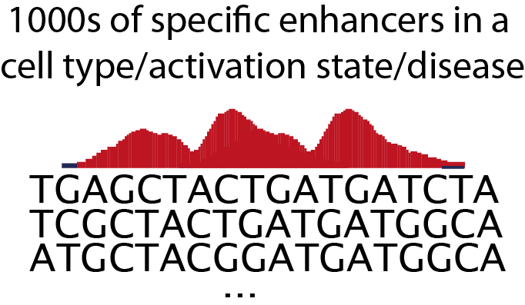
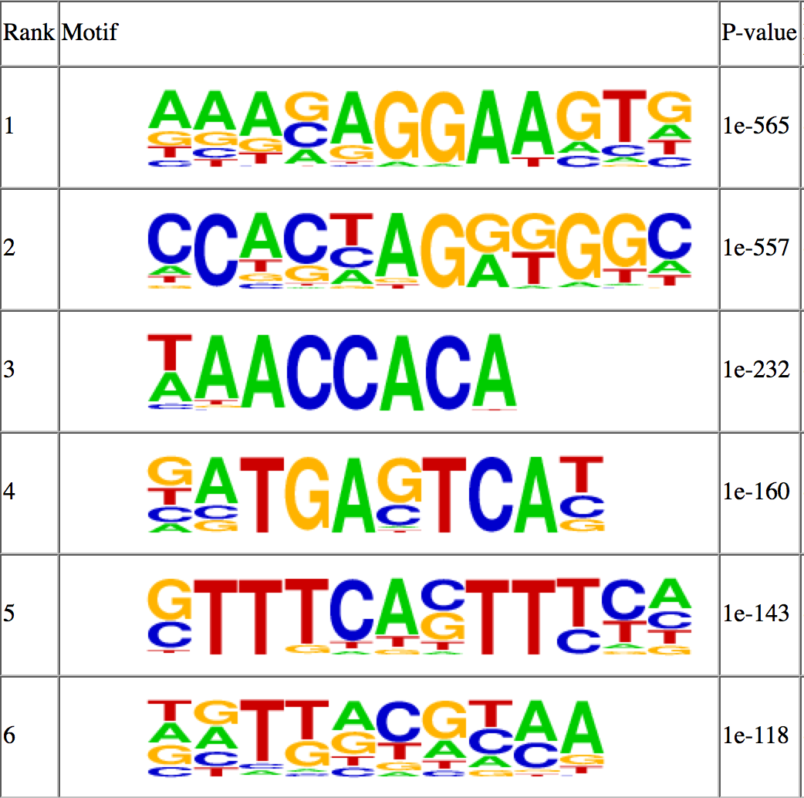
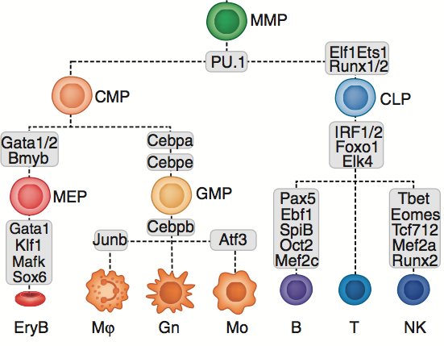
Background
Chromatin states – more than gene expression!
Infer regulatory networks
Function of DNA sequence
Motif analysis
Activity
Potential
^{Lara-Astiaso, Science 2014}

Slide 6
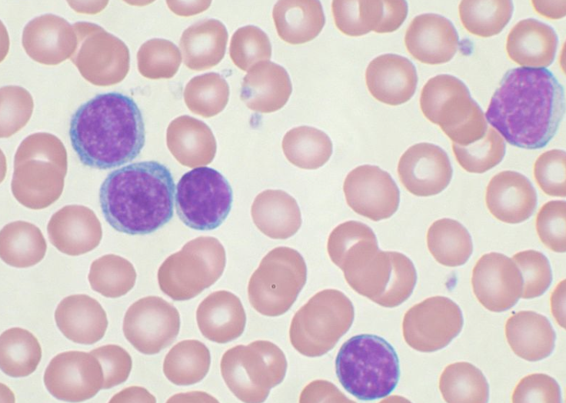
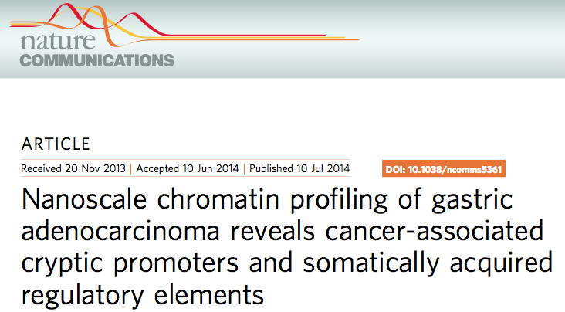

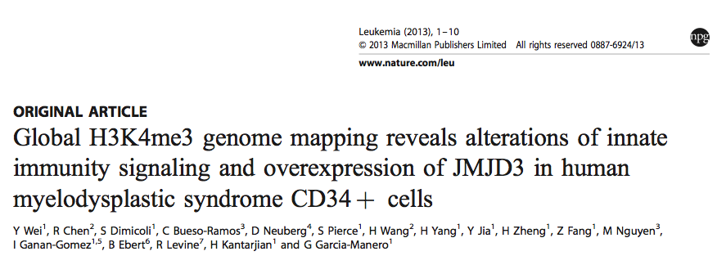
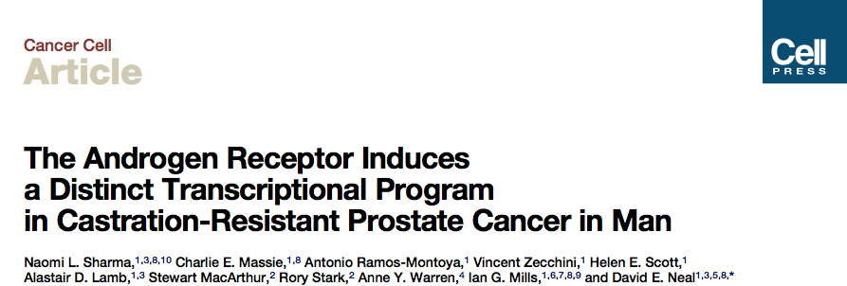
Chromatin profiling in primary cancer cells
CLL: chronic lymphocytic leukemia (around 50 patient samples from Royal Bournemouth General Hospital, England via BLUEPRINT)
First large scale analysis of the chromatin landscape in primary cancer cells
Cluster samples/compare signatures to healthy cells
Regulatory networks in CLL, decompose origin/potential of patient-specific CLL
Future plans: extend cohort, match epigenomes to clinical data, survival, develop biomarkers, rationale for drug treatment

Slide 7
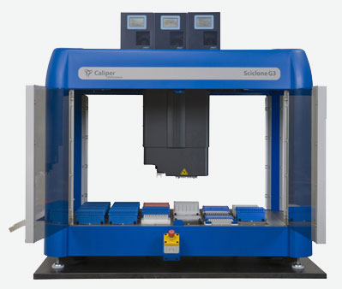
Chromatin profiling in primary cancer cells
automated ChIP-seq
ATAC-seq
high-throughput analysis of histone modifications
profiling of “open chromatin” (enhancers/promoters)
ChIPmentation

Slide 8
Chromatin profiling in primary cancer cells
automated ChIP-seq
ATAC-seq
high-throughput analysis of histone modifications
profiling of “open chromatin” (enhancers/promoters)
ChIPmentation

Slide 9
Study chromatin modifications – ChIP-seq
Fix protein-DNA with formaldehyde
Lyse cells to isolate nuclei
Bind protein of interest (with fixed DNA) to a specific antibody (e.g. H3K27ac to study enhancers)
Wash complexes
Purify DNA
Prepare Illumina-compatible library (end repair, phosphorylation, A-tailing, adaptor ligation, PCR)
Sonicate chromatin to small fragments
-T
℗
-A
A-
℗
T-

Slide 10
Current limitations to do ChIP-seq on large numbers of primary samples
Required material: Standard approaches recommend 1-10 Mio+ cells per immunoprecipitation
ChIP-seq is laborious and takes time (3 days ChIP, 1-2 days library preparation)

Slide 11
Current limitations to do ChIP-seq on large numbers of primary samples
Required material: Standard approaches recommend 1-10 Mio+ cells per immunoprecipitation
ChIP-seq is laborious and takes time (3 days ChIP, 1-2 days library preparation)

Slide 12
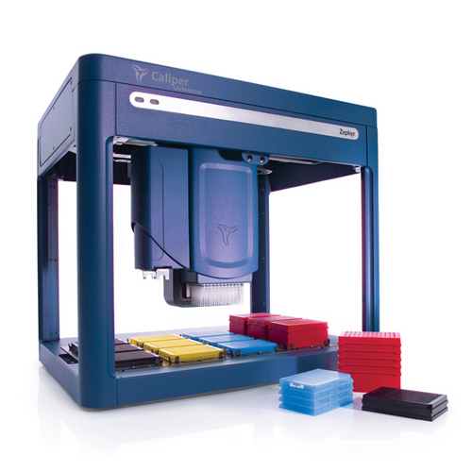
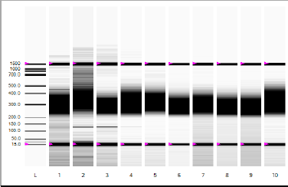
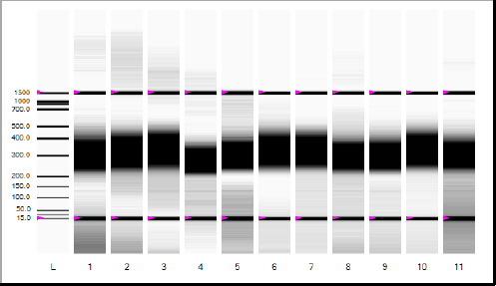
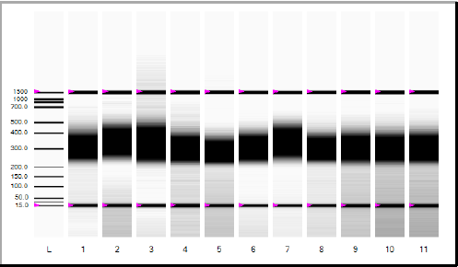
Automatition of ChIP-seq
Chromatin preparation (1/2 day)
Immunoprecipitation, washing of the IP, elution and DNA purification (1,5 days)
Quality control off-deck (qPCR) (1.5 hours)
Library preparation (1 day)
Enrichment PCR (2-3 hours)
Purification (2-3 hours)
Quality control of the libraries (1 day)
50% less hands-on-time
Higher throughput (in theory 96 IPs)
50% reduction in library cost
➔ First library run with 32 samples successful
Thomas Penz, Perkin Elmer

Slide 13
Chromatin profiling in primary cancer cells
automated ChIP-seq
ATAC-seq
high-throughput analysis of histone modifications
profiling of “open chromatin” (enhancers/promoters)
✗
✔
low cell numbers
many samples
ChIPmentation

Slide 14
Chromatin profiling in primary cancer cells
automated ChIP-seq
ATAC-seq
high-throughput analysis of histone modifications
profiling of “open chromatin” (enhancers/promoters)
✔
many samples
ChIPmentation

Slide 15
Assay for transposase-accessible chromatin using sequencing (ATAC-seq) with 50.000 cells
Add transposase (NEXTERA kit for library preparation)
Purify DNA and amplify fragments to enrich for “open chromatin”
Isolate nuclei and permeabelize cells
Delivers adapters much easier in “open chromatin” (enhancers, promoters, insulators)
Buenrostro et al. 2013 Nat. Methods

Slide 16
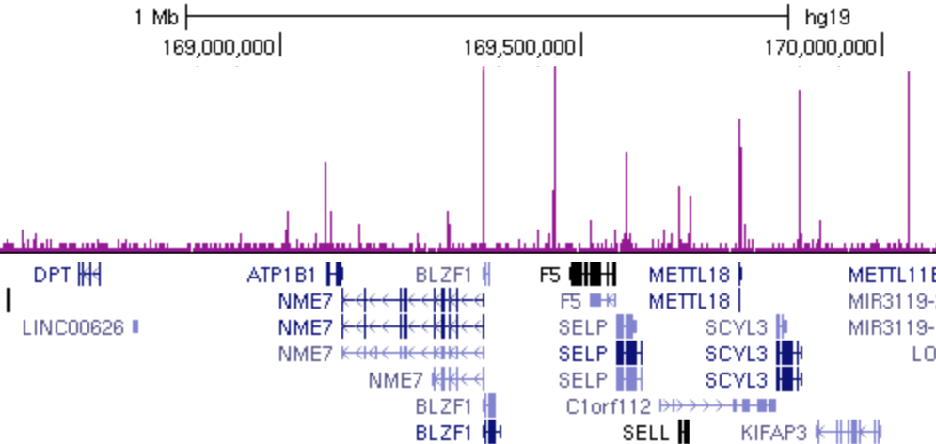
ATAC-seq on PBMCs
ATAC-seq peak distribution
ATAC-seq signal
ATAC-seq signal corresponds to regulatory elements
Problem: 50+ % of reads map to mitochondria
Very variable between cell types

Slide 17
Chromatin profiling in primary cancer cells
automated ChIP-seq
ATAC-seq
high-throughput analysis of histone modifications
profiling of “open chromatin” (enhancers/promoters)
✔
many samples
✔
low cell numbers
ChIPmentation

Slide 18
Chromatin profiling in primary cancer cells
automated ChIP-seq
ATAC-seq
high-throughput analysis of histone modifications
profiling of “open chromatin” (enhancers/promoters)
✔
many samples
✔
low cell numbers
ChIPmentation

Slide 19
ChIPmentation
Fix protein-DNA with formaldehyde
Lyse cells to isolate nuclei
Wash complexes again to remove unspecific library fragments
Immunoprecipitate complexes
Sonicate chromatin to small fragments
Wash complexes
Add transposase to prepare library
Isolate DNA/library

Slide 20
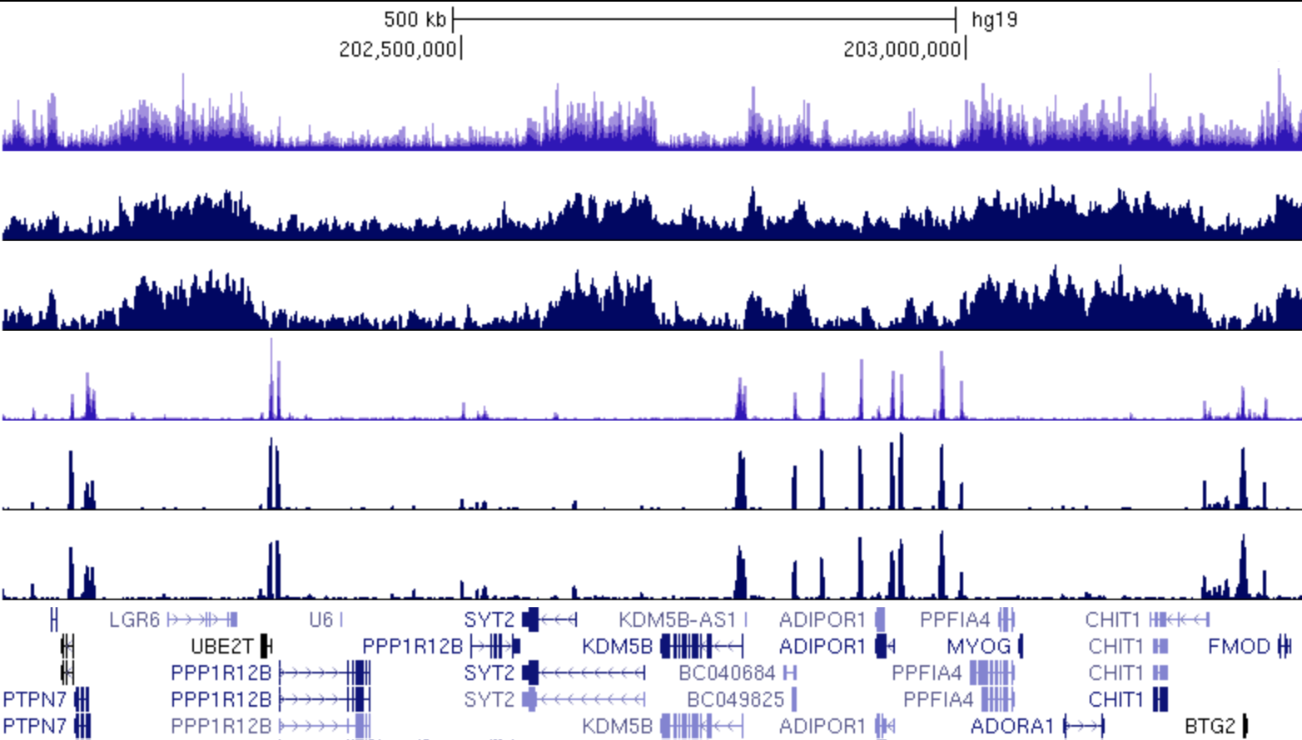
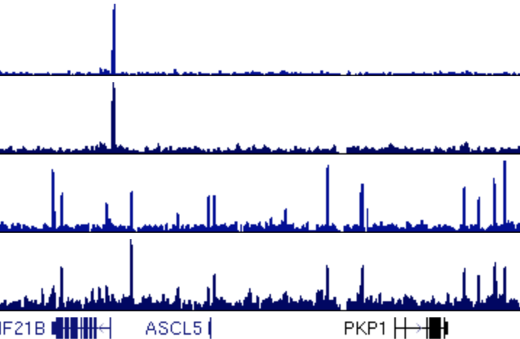
Peformance of ChIPmentation
H3K27me3 ENCODE
ChIP an “active” and “repressive” histone modification in K562
H3K27me3 normal ChIP
H3K27me3 ChIPmentation
H3K4me3 ENCODE
H3K4me3 normal ChIP
H3K4me3 ChIPmentation
PU.1 500k normal ChIP
Transcription factors do also work albeit there are still background issues
PU.1 500k ChIPmentation
CTCF 500k normal ChIP
CTCF 500k ChIPmentation

Slide 21
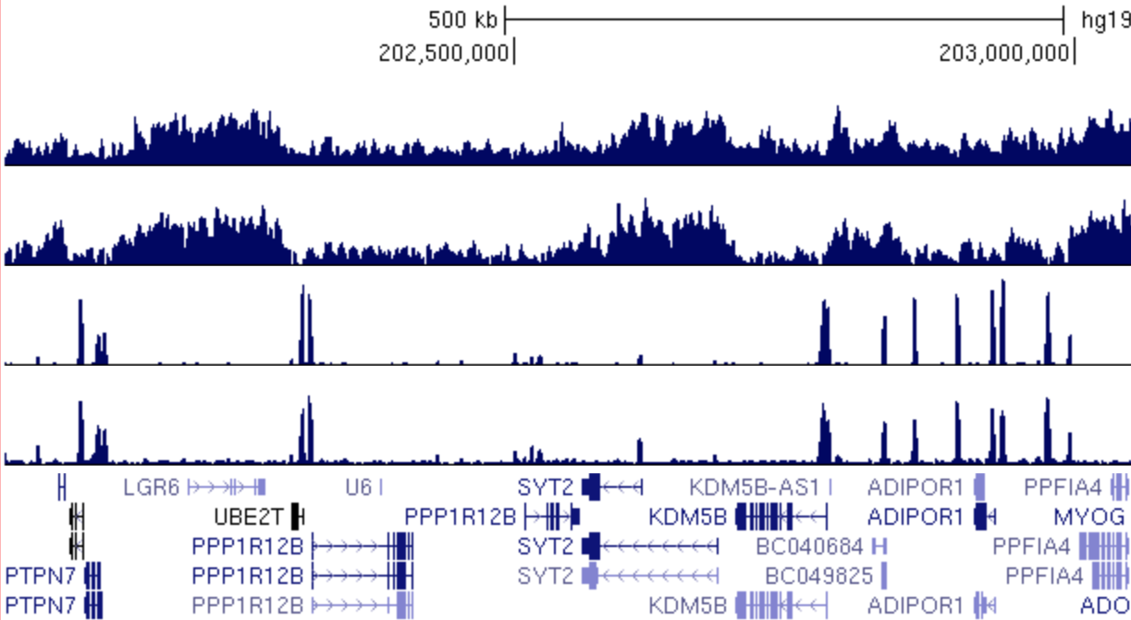
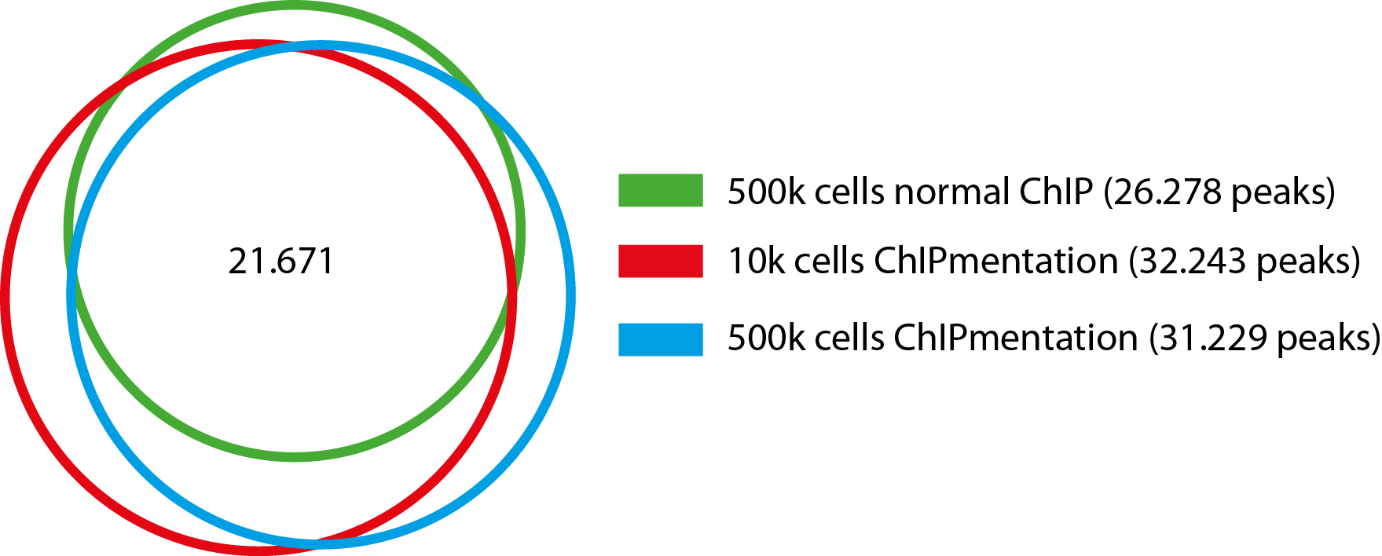
ChIPmentation with low amount of input
H3K27me3 500k
H3K27me3 10k
H3K4me3 500k
H3K4me3 10k
H3K4me3 peaks

Slide 22
ChIP-seq vs. ChIPmentation
 | Illumina TruSeq | ChIPmentation
Input requirements (good histone antibodies) | 500k | 10.000 cells (maybe less)
Library preparation time (without enrichment PCR) | 3 hours | 10-20 min
Library preparation cost | ~40 Euro | ~10 Euro

Slide 23
ChIPmentation might have a higher information content than „normal“ ChIP-seq
ChIPmentation
normal ChIP
corresponds to transposase insertion site

Slide 24
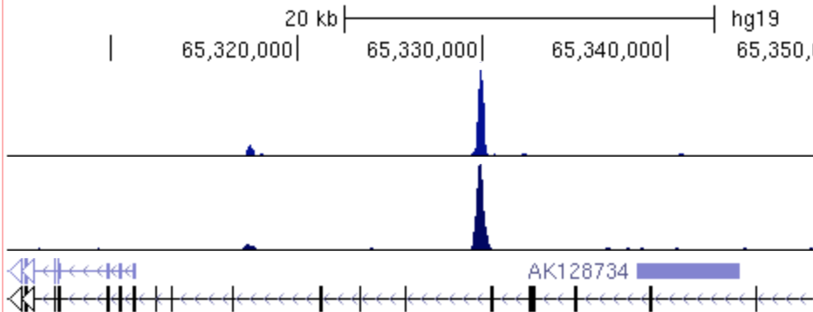
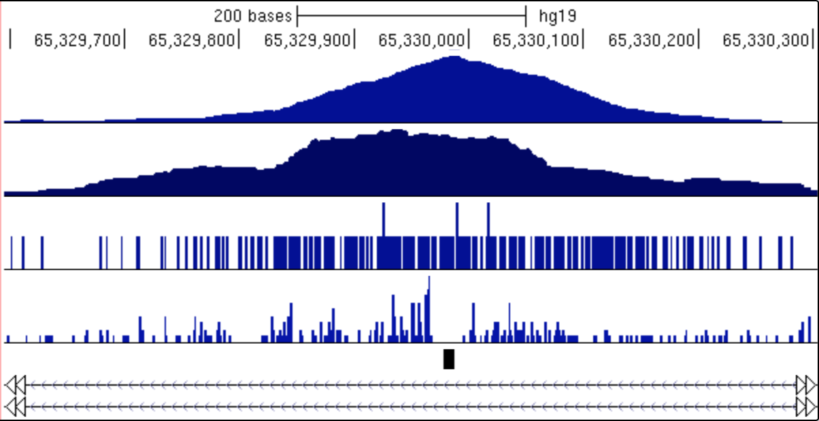

ChIPmentation might have a higher information content than „normal“ ChIP-seq
PU.1 norm ChIP
PU.1 norm ChIP
PU.1 ChIPmentation
PU.1 ChIPmentation
PU.1 norm ChIP 1bp
PU.1 ChIPmentation 1bp
PU.1 DNA binding motif
“Footprint” where transcription factor is in physical contact with DNA
new insights into protein-DNA interactions? Adjacent footprints of co-bound TFs?
Information comes along for free with ChIP

Slide 25
Chromatin profiling in primary cancer cells
automated ChIP-seq
ATAC-seq
high-throughput analysis of histone modifications
profiling of “open chromatin” (enhancers/promoters)
✔
many samples
✔
low cell numbers
ChIPmentation
✔
low cell numbers
✔
fast, cheap, automatable
✔
high information content

Slide 26
Summary of progress since last lab talk
Methods established to analyze chromatin in a large number of samples
ChIPmentation – fast, cheap, sensitive, informative – the method for CLL?
My next goal
Finalize the analysis and publish ChIPmentation as a method paper
Feedback required
A different point of view on ChIPmentation – ideas for analysis? Patent?

